Slide 1
CSI2005 Principles of Compiler Design
MODULE - 3
Dr. WI. Sureshkumar
Associate Professor
School of Computer Science and Engineering (SCOPE)
VIT Vellore
wi.sureshkumar@vit.ac.in
SJT413A34

Slide 2
LR Parser
LR parsers used to parse a large class of context-free grammars.
The technique is called LR(k) parsing:
L denotes that input sequence is processed from left to right
R denotes that the right most derivation is performed.
k denotes that at most k symbols are used to make a decision.
Reasons for the attractiveness of LR parser
LR parsers can handle a large class of CF grammars.
An LR parser can detect syntax errors as soon as they occur.
The LR parsing method is the most general non back tracking shift-reduce parsing method.
LR parsers can handle all language recognized by LL(1).

Slide 3
LR Parser
Drawbacks of the method
Parsing tables are too complicated to be generated by hand, need an automated generator.
Cannot handle ambiguous grammar without special tricks.

Slide 4

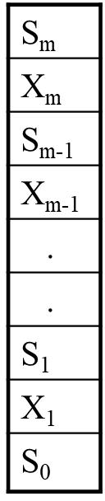
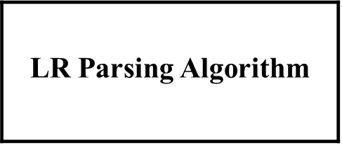
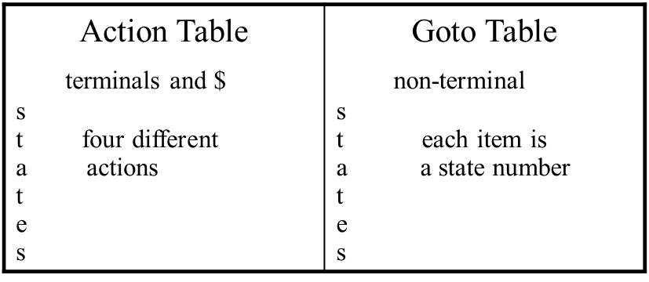
LR Parser Algorithm
input
output

Slide 5
LR Parser
LR parser consists of an
1. input
2. output
3. stack
4. driver (parser) program
5. parse table
1. action
2. goto

Slide 6
LR Parser
The driver program is same for all LR parsers.
Only the parsing table changes from one parser to another.
The parsing program reads character from an input buffer one at a time.
The program uses a stack to store a string of the form
S₀ X₁ S₁ X₂ S₂ X₃ . . . . X_{m} S_{m}
where S_{m} is on top of the stack
each S_{i} is a symbol called state
each X_{i} is a grammar symbol

Slide 7
action and goto
The function action takes a state and input symbol as arguments and produces one of four values:
Shift S where S is a state
Reduce by a grammar production A → β
Accept
Error
The function goto takes a state and a grammar symbol as arguments and produces a state.

Slide 8
Construction of LR Parsing Table
There are three techniques for constructing LR parsing table for a grammar.
SLR (Simple LR)
Canonical LR
LALR (Look ahead LR)

Slide 9
Construction of SLR Parsing Table
The central idea is the construction of a DFA from the grammar.
LR(k) parser uses stack content and the next k symbols of the input to decide what is to be done.
LR(0) parser uses only stack contents.
Let G = (N, T, P ,S) be a CFG.
[ A → w₁ . w₂ , u ] is called LR(k) item if A → w₁ . w₂ is a production
from P, and u is a sequence of terminals, the length of which is less
or equal to k.
LR(0) items should not contain sequence of terminals i.e.,
[ A → w₁ . w₂ ]

Slide 10
LR(0) item
A production A → XYZ generates four LR(0) items
A → .XYZ A →X.YZ A → XY.Z A → XYZ.
One collection of sets of LR(0) items is called the canonical LR(0) collection.
To construct the canonical LR(0) collection for a grammar, we need to define an augmented grammar two functions, namely
Closure
goto

Slide 11
Augmented grammar
If G is a grammar with start symbol S, then G’, the augmented grammar for G, is G with a new start symbol S’ and production S’ → S.
If G = (N, T, P, S), then G’ = (N U {S’} , T, PU {S’ → S} , S’)
The purpose of this new starting production is to indicate to the parser when it should stop parsing and announce acceptance of the input.

Slide 12
Closure
If I is a set of items for a grammar G, then the Closure(I) is the set of items constructed from I by the following rules:
Every item in I is added to closure(I)
If A →α.Bβ is in closure(I) and B → γ is a production, then add item B → .γ to I, if it is not already there.
Repeat the step (2) until no more new items can be added to closure(I)

Slide 13
Example
Consider the augmented grammar
E’ → E
E → E + T / T
T → T * F / F
F → ( E ) / id
If I is set of one item {[E’ → .E]}, then closure(I) contains the items
E’ → .E
E → .E + T
E → .T
T → .T * F
T →.F
F →.( E )
F →.id

Slide 14
goto
goto(I, X), where I is set of items and X is a grammar symbol, is
defined to be the closure of the set of all items [A →αX.β] such that
A →α.Xβ is in I
The goto moves the dot behind the X symbol. That means the transition is performed from one state to another under the effect of the symbol X

Slide 15
Example
If I is the set of two items {[E’ → .E , E → E .+ T ]} then goto(I , +) consists of closure of { E → E +. T}
E → E + .T
T → .T * F
T →.F
F →.( E )
F →.id

Slide 16
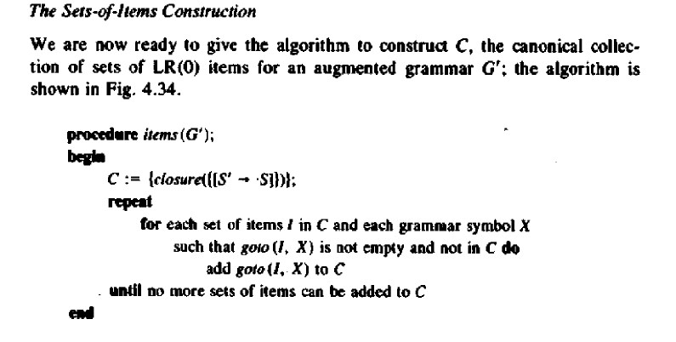

Slide 17
Collection of Canonical LR(0) Sets of Items
I₀ : E’ → .E goto(I₀ , T) = I₂ goto(I₀ , ( ) = I₄
E → .E + T I₂ : E → T. I₄ : F →(. E )
E → .T T → T. * F E → .E + T
T → .T * F E → .T
T →.F goto(I₀ , F) = I₃ T → .T * F
F →.( E ) I₃ : T →F. T →.F
F →.id F →.( E )
goto(I₀ , id) = I₅ F →.id
goto(I₀ , E) = I₁ I₅ : F → id.
I₁ : E’ → E.
E → E. + T

Slide 18
goto(I₁ , + ) = I₆ goto(I₄ , E ) = I₈ goto(I₄ , ( ) = I₄
I₆ : E → E + .T I₈ : F →( E. ) F →(. E )
T → .T * F E → E .+ T E → .E + T
T →.F T → .T * F
F →.( E ) goto(I₄ , T ) = I₂ T →.F
F →.id E → T. F →.( E )
goto(I₂ , * ) = I₇ T → T. * F F →.id
I₇ : T → T *. F
F →.( E ) goto(I₄ , F ) = I₃ goto(I₄ , id ) = I₅
F →.id T →F. F →id.

Slide 19
goto(I₆ , T ) = I₉ goto(I₆ , ( ) = I₄ goto(I₆ , id ) = I₅
I₉ : E → E + T. F →(. E ) F →id.
T → T. * F E → .E + T
E→ .T goto(I₇ , ( ) = I₄
goto(I₆ , F ) = I₃ T → .T * F F →(. E )
T → F. T →.F E → .E + T
F →.( E ) E→ .T
F →.id T → .T * F
T →.F
goto(I₇ , F ) = I₁₀ goto(I₇ , id ) = I₅ F →.( E )
I₁₀ : T → T * F. F →id. F →.id

Slide 20
goto(I₈ , +) = I₆ goto(I₉ , *) = I₇
E → E + .T T → T *. F
T → .T * F F →.( E )
T →.F F →.id
F →.( E )
F →.id
goto(I₈ , )) = I₁₁
I₁₁ : F → ( E ).

Slide 21
E → E + T ------(1) FOLLOW(E) = { +, ), $}
E → T ------(2) FOLLOW(T) = {+, *, ), $ }
T → T * F ------(3) FOLLOW(F) = {+, *, ), $}
T → F ------(4)
F → ( E ) ------(5)
F → id ------(6)

Slide 22
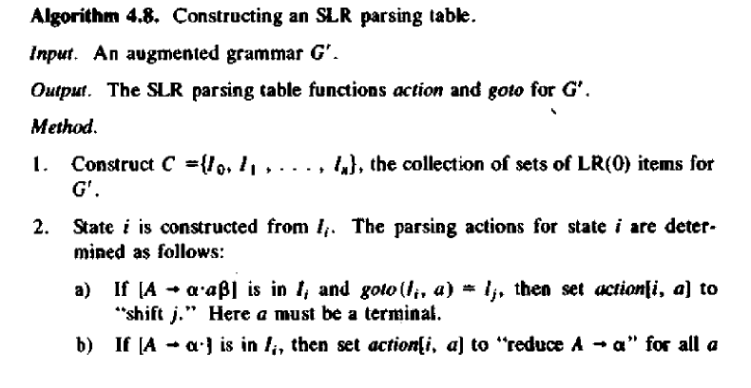

Slide 23
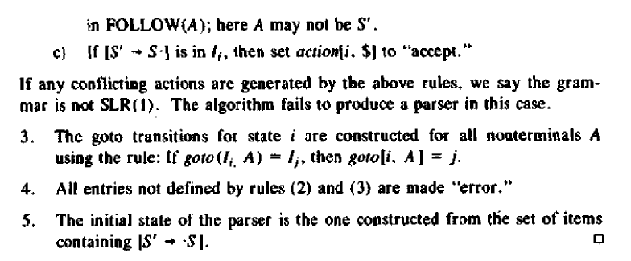

Slide 24
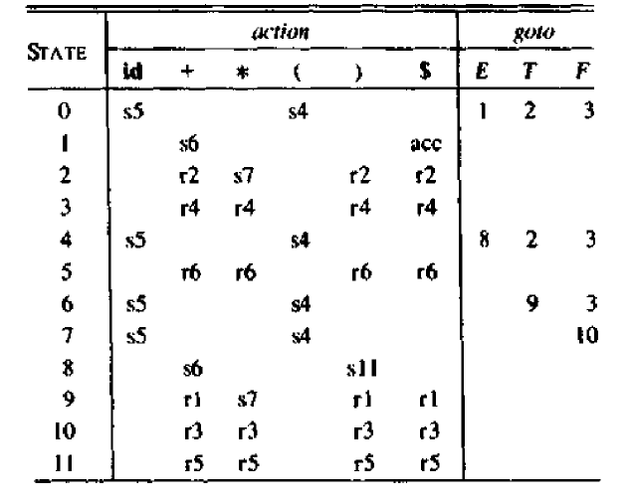

Slide 25
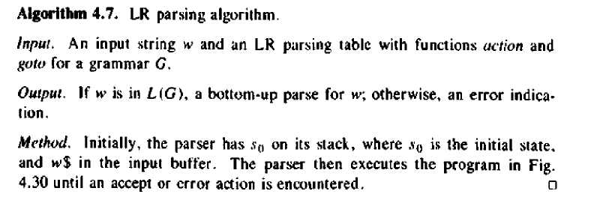

Slide 26
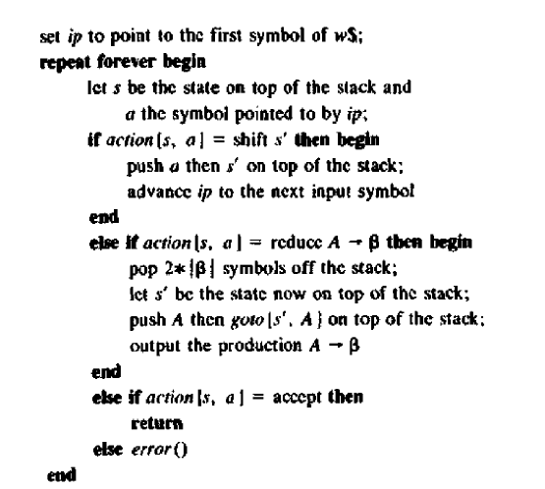

Slide 27
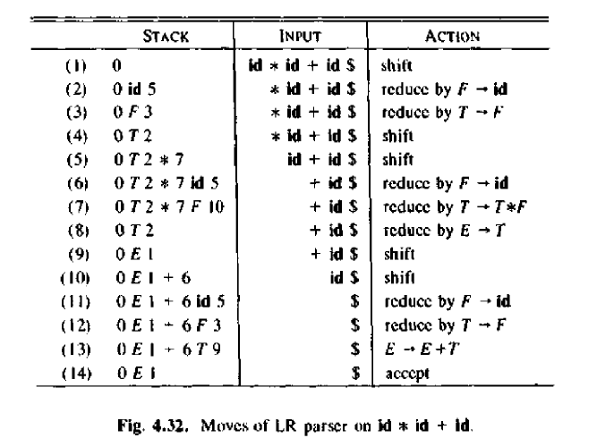

Slide 28
FOLLOW(E’) = { $ }
FOLLOW(E) = { +, ), $ }
FOLLOW(T) = { *,+, ), $ }
FOLLOW(F) = { *,+, ), $ }
E → E + T (rule 1)
E → T (rule 2)
T → T * F (rule 3)
T → F (rule 4)
F → ( E ) (rule 5)
F → id (rule 6)

